Slide 1

AUTOMATION TESTING ON
DEMOBLAZE
TEAM MEMBER
TRAINER
1. Bhavani Kakarla
2. Peddamathari Balakrishna
3. Divya Harshitha Kalapala
4. Gayatri Loni
5. Km Shikha Nigam
6. Khushboo Bhatia
7. Maruthi Praveen Sagabala
ANAND BHAKTHAVATHSALA

Slide 2
INTRODUCTION
DemoBlaze is a user-friendly e-commerce website specializing in a wide range of electronic products, including smartphones, laptops, and tablets. It provides a seamless shopping experience with features such as detailed product listings, a convenient shopping cart, and a streamlined checkout process. Users can browse through various product categories, compare items, and make secure purchases. The website also offers user account management, allowing customers to log in, and manage their personal information. With its focus on ease of use and efficiency, DemoBlaze serves as a robust platform for online shopping, making it a valuable target for thorough automation testing to ensure functionality, reliability, and an optimal user experience.

Slide 3
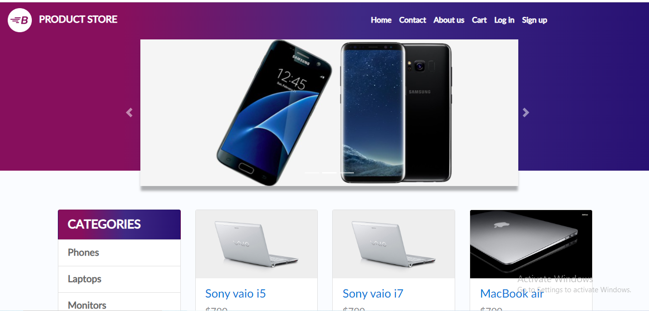
Problem Statement
Demoblaze is an online shopping platform where users can browse and purchase various electronic products . Users can browse through different categories and Users interact with the platform to view product details, add products to the cart, place orders. Automating these workflows is essential to ensure the platform's efficiency, accuracy, and reliability in the testing process.

Slide 4
Objective
The objective of this project is to automate the user workflows of the Demoblaze online shopping platform using Selenium, TestNG, Cucumber and Junit. This includes automating tasks such as viewing product details, adding products to the cart, placing orders. The aim is to enhance the robustness of the testing process, reduce manual effort, and ensure a seamless user experience.

Slide 5
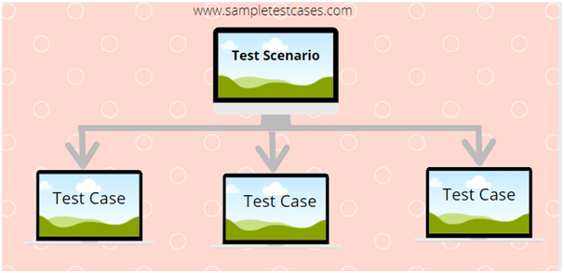
Test Scenarios
LOGIN
SIGN UP
HOME PAGE
CONTACT
PLACE ORDER
CART
LOGOUT

Slide 6
Test Flow
HOME
USER
LOGIN
SIGN
UP
ADD TO
CART
LOGOUT
CONTACT
PLACE ORDER

Slide 7
EXTENT REPORT
"The Extent Reports framework plays a crucial role in enhancing the visibility of test results in our automation testing project for the DemoBlaze website. With its sophisticated HTML reporting capabilities, Extent Reports provides a comprehensive overview of test execution, highlighting both successful and failed test cases. Each test report includes detailed logs, screenshots of errors, and a summary of the test case status. This rich reporting format not only aids in quick issue identification but also supports effective communication with stakeholders by presenting test results in a clear and visually appealing manner."

Slide 8
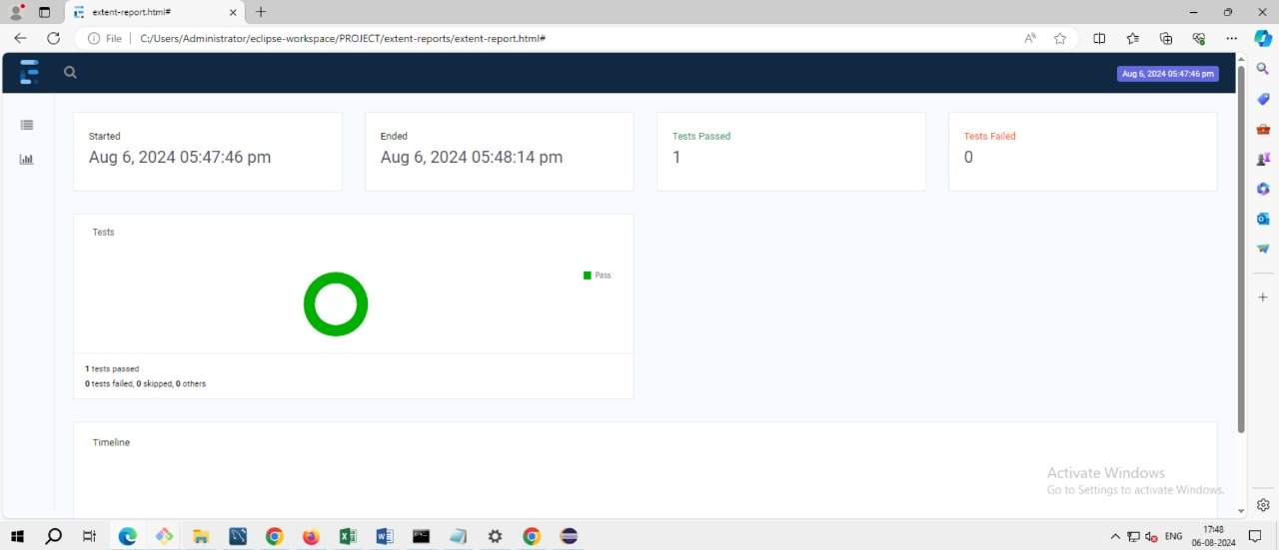
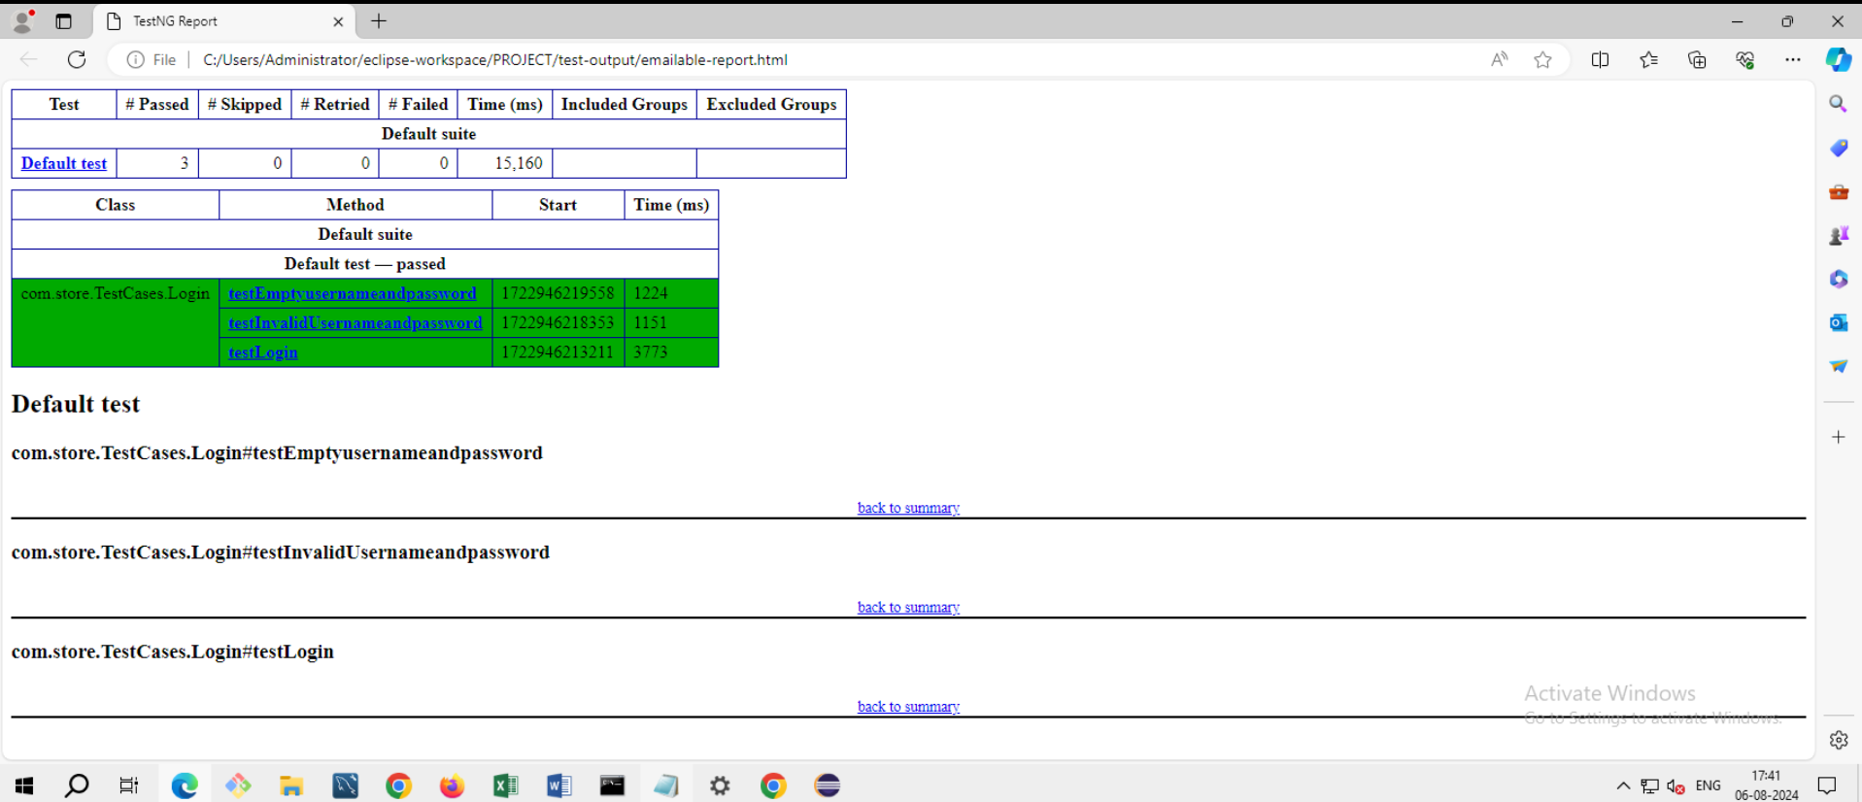
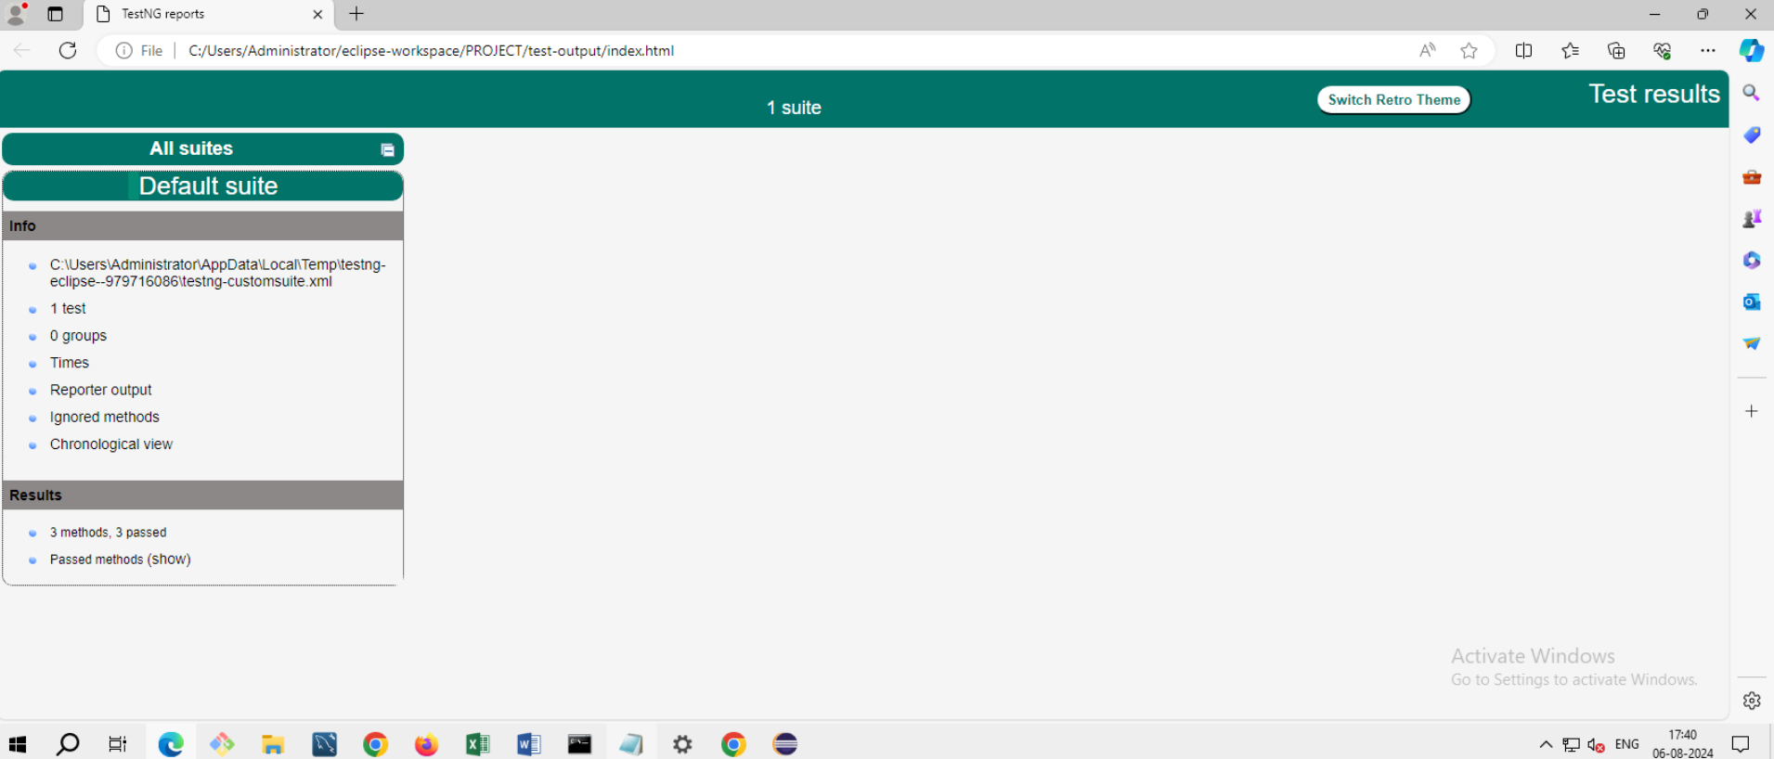
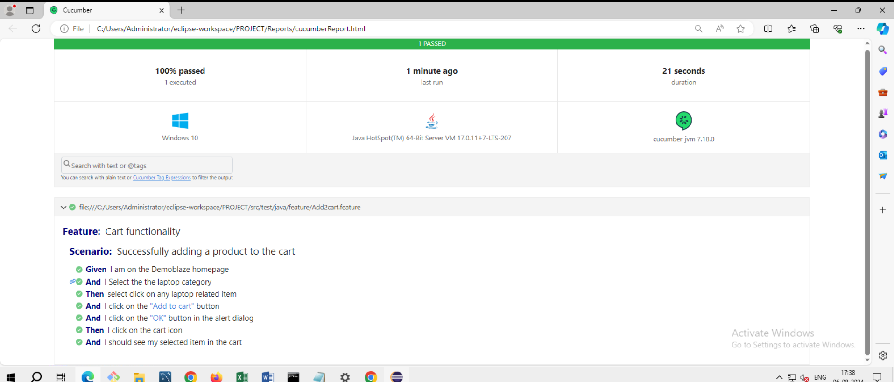

Slide 9
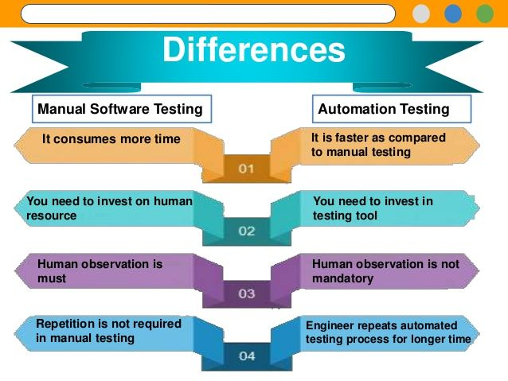
AUTOMATION OVER MANUAL TESTING

Slide 10




"OUR EXPLORATION TO AUTOMATION SUCCESS"
This Photo by Unknown Author is licensed under CC BY-SA
This Photo by Unknown Author is licensed under CC BY-NC

Slide 11
Conclusion
The automation testing project for the DemoBlaze website effectively demonstrated how automated testing enhances web application quality and reliability. Using Selenium, Java, JUnit and Cucumber, we systematically tested key functionalities such as login, product search, cart management, and checkout.
The Page Object Model and Cucumber’s BDD framework provided efficient test case management and clear scenarios. Extent Reports offered detailed insights into test results, revealing both successes and areas for improvement. Overall, the project confirmed that automation significantly improves the testing process, ensuring high standards of web application performance and user experience.

Slide 12


